Slide 1

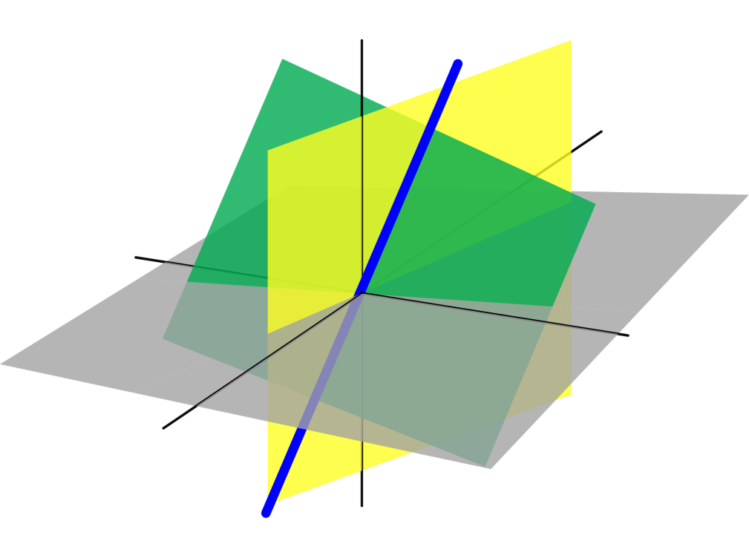
Azərbaycan Dövlət Neft və Sənaye Universiteti
Linear Algebra

Slide 2
In our previous lecture we concentrated on the mechanics of the three basic matrix operations:
matrix addition
scalar multiplication
matrix multiplication
This lecture begins to develop the algebra of matrices. You will see that this algebra shares many (but not all) of the properties of the algebra of real numbers.
Properties of Matrix Operations

Slide 3
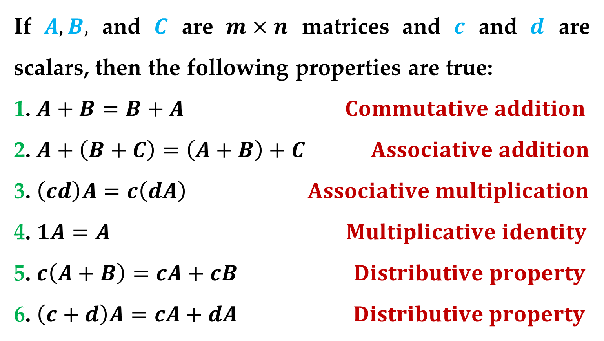
Theorem 1. Properties of Matrix Addition and Scalar
Multiplication
If $A,B,$ and $C$ are $m×n$ matrices and $c$ and $d$ are scalars, then the following properties are true:
1. $A+B=B+A Commutative addition$
2. $A+\left(B+C\right)=\left(A+B\right)+C Associative addition$
3. $\left(cd\right)A=c\left(dA\right) Associative multiplication$
4. $1A=A Multiplicative identity$
5. $c\left(A+B\right)=cA+cB Distributive property$
6. $\left(c+d\right)A=cA+dA Distributive property$
Properties of Matrix Operations

Slide 4
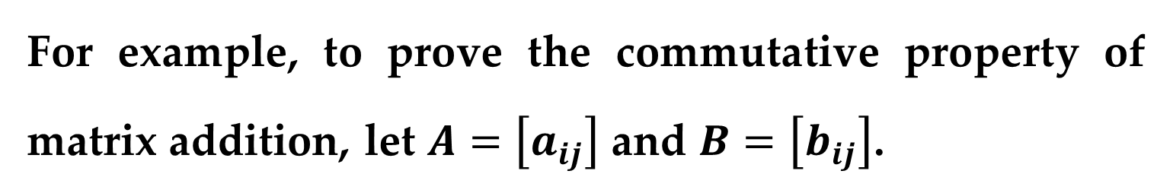
Proof
The proofs of these six properties follow directly from the definitions of matrix addition, scalar multiplication, and the corresponding properties of real numbers.
For example, to prove the commutative property of matrix addition, let $A=\left[a_{ij}\right]$ and $B=\left[b_{ij}\right]$.
Properties of Matrix Operations

Slide 5
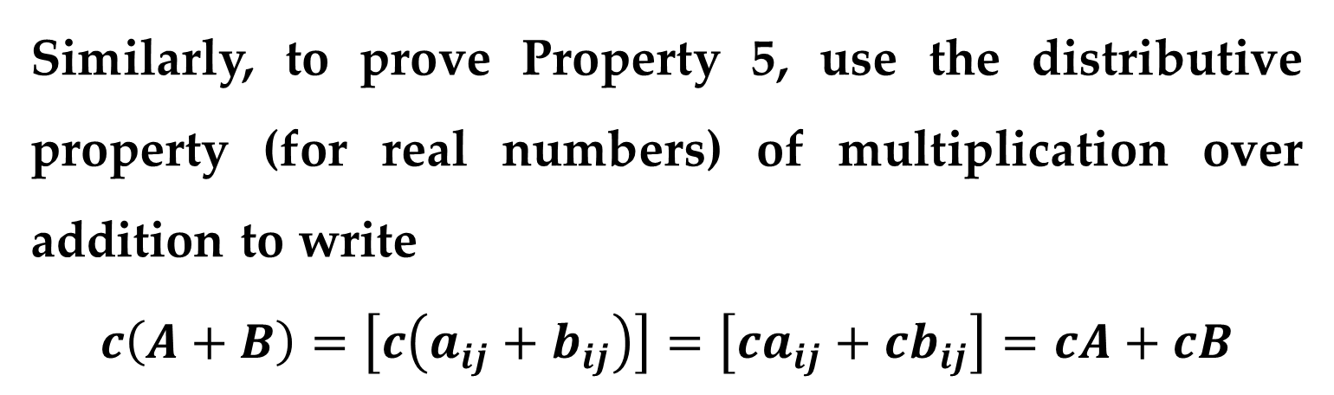
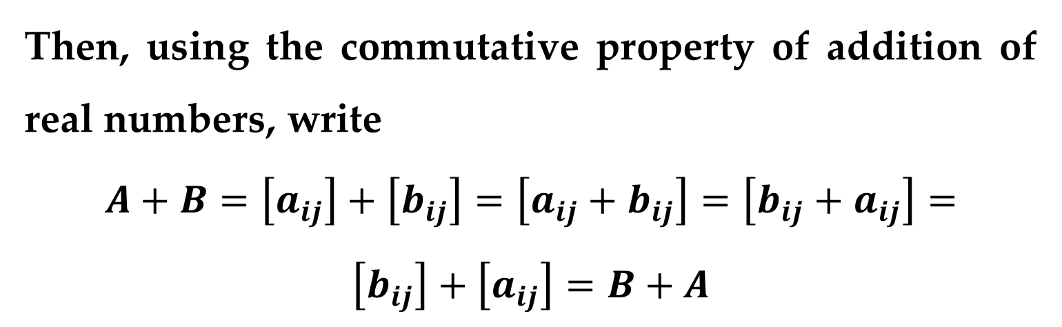
Proof (continued)
Then, using the commutative property of addition of real numbers, write
$$A+B=\left[a_{ij}\right]+\left[b_{ij}\right]=\left[a_{ij}+b_{ij}\right]=\left[b_{ij}+a_{ij}\right]=$$
$$\left[b_{ij}\right]+\left[a_{ij}\right]=B+A$$
Similarly, to prove Property 5, use the distributive property (for real numbers) of multiplication over addition to write
$$c\left(A+B\right)=\left[c\left(a_{ij}+b_{ij}\right)\right]=\left[ca_{ij}+cb_{ij}\right]=cA+cB$$
Properties of Matrix Operations

Slide 6
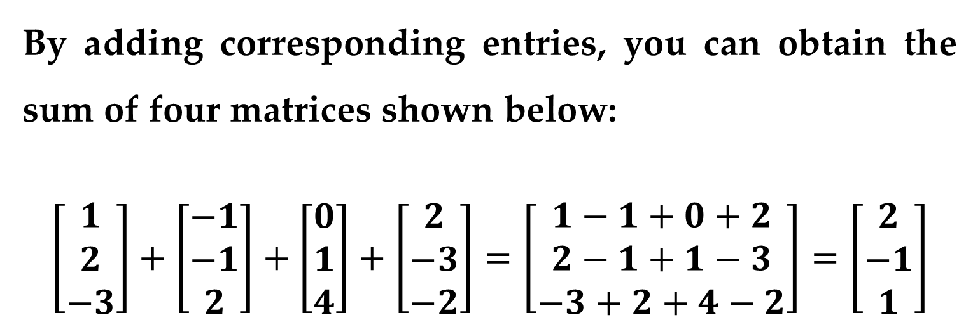
Example 1. Addition of More than Two Matrices
By adding corresponding entries, you can obtain the sum of four matrices shown below:
$$\left[\begin{matrix}1 \\ 2 \\ −3\end{matrix}\right]+\left[\begin{matrix}−1 \\ −1 \\ 2\end{matrix}\right]+\left[\begin{matrix}0 \\ 1 \\ 4\end{matrix}\right]+\left[\begin{matrix}2 \\ −3 \\ −2\end{matrix}\right]=\left[\begin{matrix}1−1+0+2 \\ 2−1+1−3 \\ −3+2+4−2\end{matrix}\right]=\left[\begin{matrix}2 \\ −1 \\ 1\end{matrix}\right]$$
Properties of Matrix Operations

Slide 7
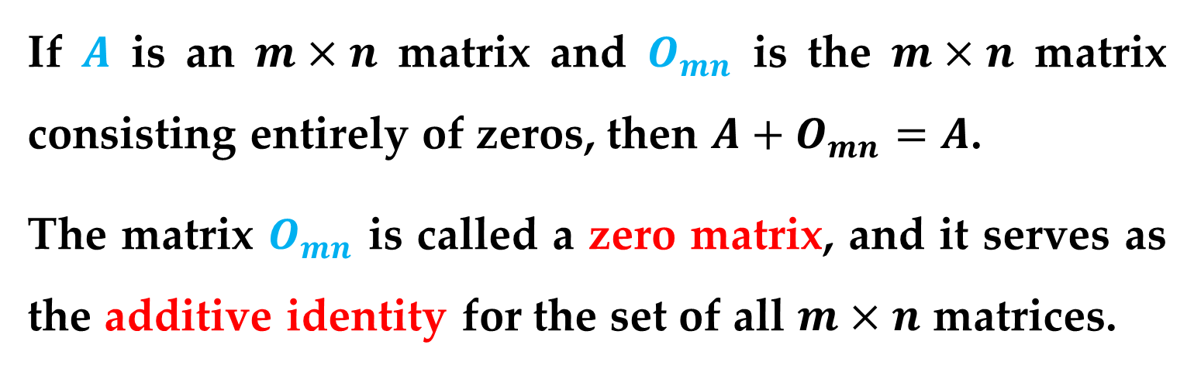
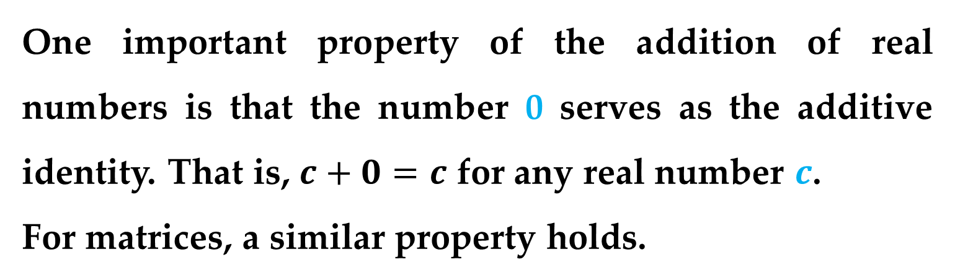
One important property of the addition of real numbers is that the number 0 serves as the additive identity. That is, $c+0=c$ for any real number $c$.
For matrices, a similar property holds.
Definition
If $A$ is an $m×n$ matrix and $O_{mn}$ is the $m×n$ matrix consisting entirely of zeros, then $A+O_{mn}=A$.
The matrix $O_{mn}$ is called a zero matrix, and it serves as the additive identity for the set of all $m×n$ matrices.
Properties of Matrix Operations

Slide 8
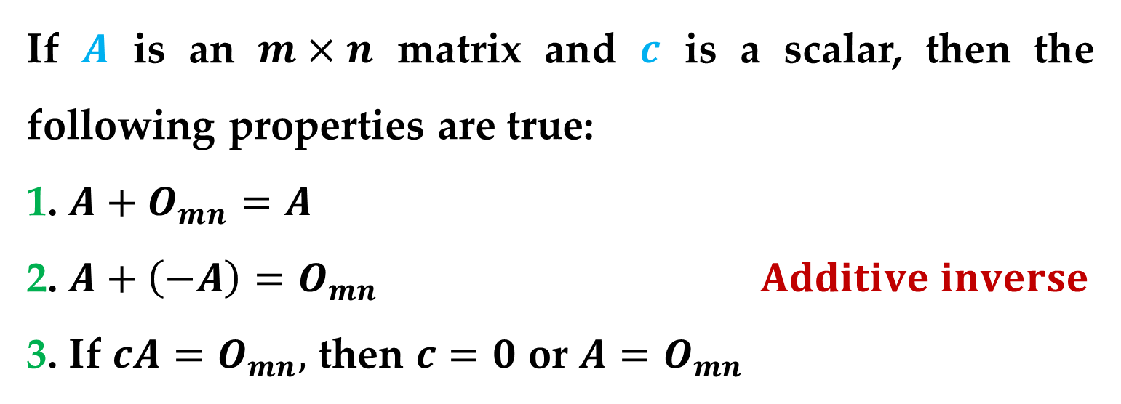
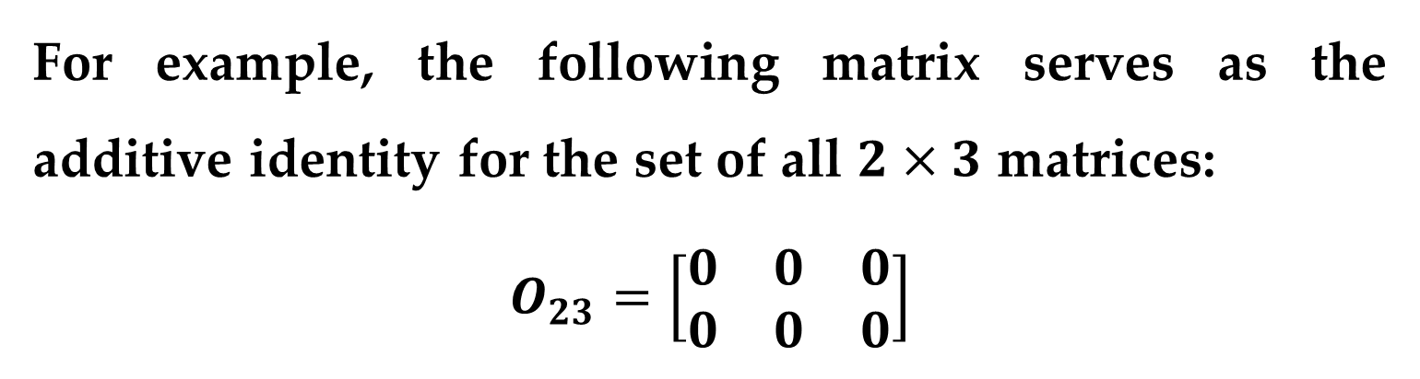
For example, the following matrix serves as the additive identity for the set of all $2×3$ matrices:
$$O_{23}=\left[\begin{matrix}0 & 0 & 0 \\ 0 & 0 & 0\end{matrix}\right]$$
Theorem 2. Properties of Zero Matrices
If $A$ is an $m×n$ matrix and $c$ is a scalar, then the following properties are true:
1. $A+O_{mn}=A$
2. $A+\left(−A\right)=O_{mn} Additive inverse$
3. If $cA=O_{mn},$ then $c=0$ or $A=O_{mn}$
Properties of Matrix Operations

Slide 9
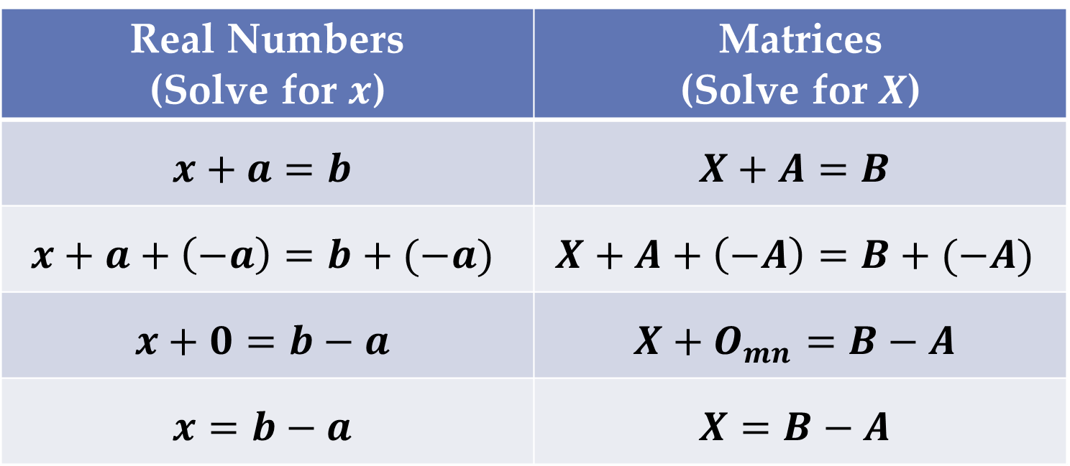
The algebra of real numbers and the algebra of matrices have many similarities. For example, compare the solutions below:
Real Numbers (Solve for $x$) | Matrices (Solve for $X$)
$$x+a=b$$ | $$X+A=B$$
$$x+a+\left(−a\right)=b+(−a)$$ | $$X+A+\left(−A\right)=B+(−A)$$
$$x+0=b−a$$ | $$X+O_{mn}=B−A$$
$$x=b−a$$ | $$X=B−A$$
Properties of Matrix Operations

Slide 10
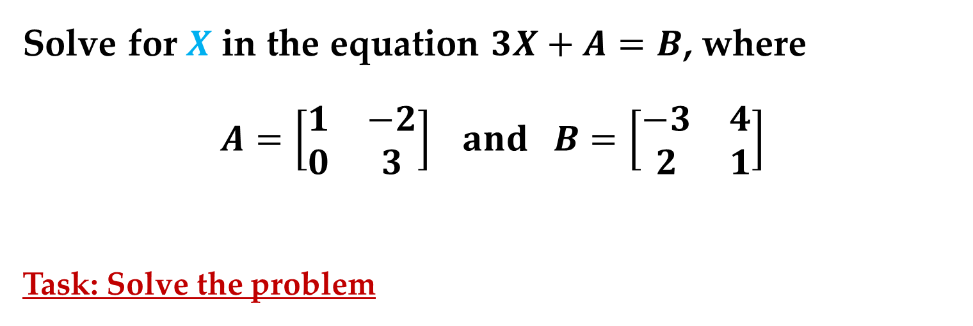
Example 2. Solving a Matrix Equation
Solve for $X$ in the equation $3X+A=B$, where
$$A=\left[\begin{matrix}1 & −2 \\ 0 & 3\end{matrix}\right] and B=\left[\begin{matrix}−3 & 4 \\ 2 & 1\end{matrix}\right]$$
Task: Solve the problem
Properties of Matrix Operations

Slide 11
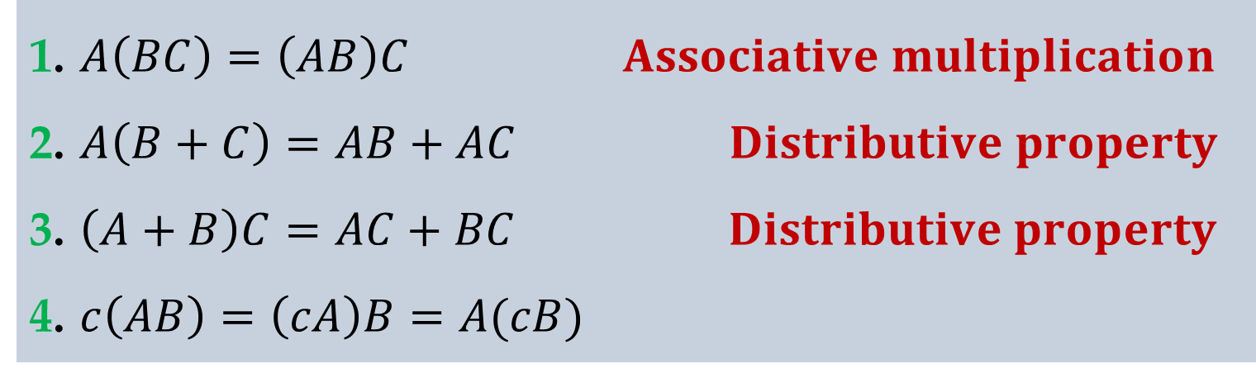
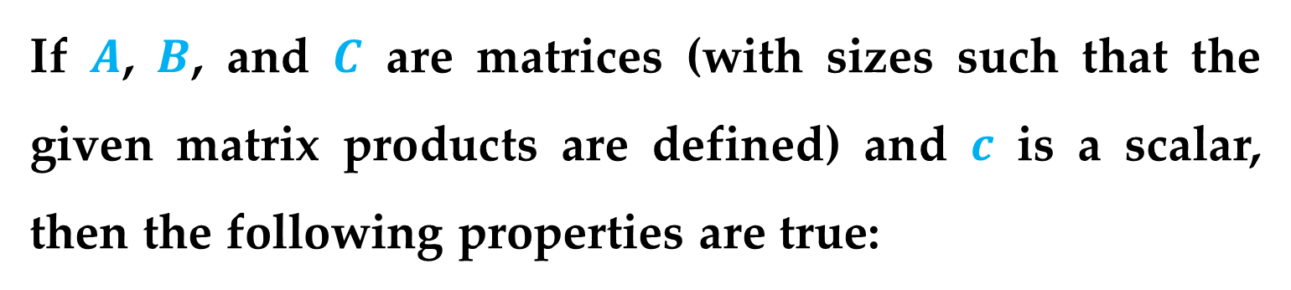
Theorem 3. Properties of Matrix Multiplication
If $A$, $B$, and $C$ are matrices (with sizes such that the given matrix products are defined) and $c$ is a scalar, then the following properties are true:
1. $A\left(BC\right)=\left(AB\right)C Associative multiplication$
2. $A\left(B+C\right)=AB+AC Distributive property$
3. $\left(A+B\right)C=AC+BC Distributive property$
4. $c\left(AB\right)=\left(cA\right)B=A(cB)$
Properties: Matrix Multiplication

Slide 12
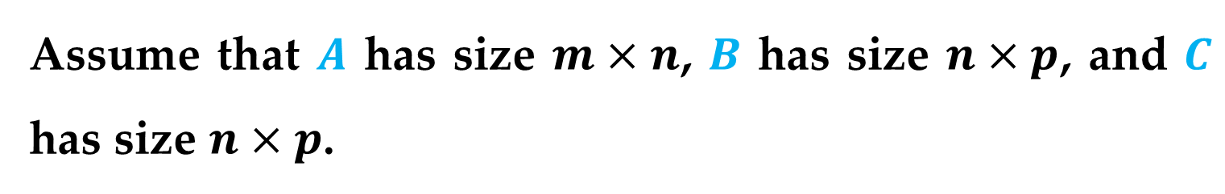
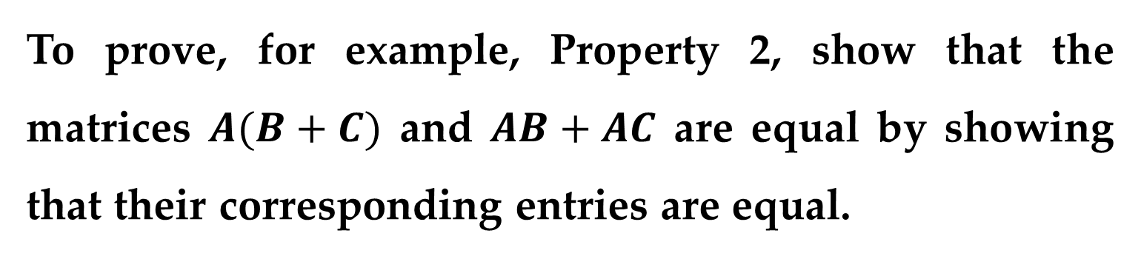
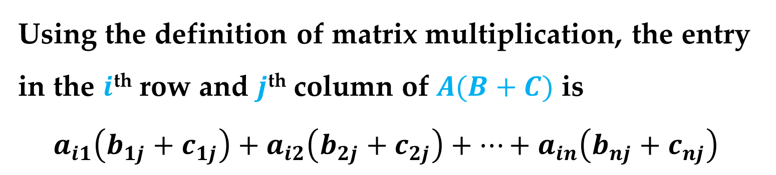
Proof
To prove, for example, Property 2, show that the matrices $A(B+C)$ and $AB+AC$ are equal by showing that their corresponding entries are equal.
Assume that $A$ has size $m×n$, $B$ has size $n×p$, and $C$ has size $n×p$.
Using the definition of matrix multiplication, the entry in the $i$^{th} row and $j$^{th} column of $A(B+C)$ is
$$a_{i1}\left(b_{1j}+c_{1j}\right)+a_{i2}\left(b_{2j}+c_{2j}\right)+…+a_{in}\left(b_{nj}+c_{nj}\right)$$
Properties: Matrix Multiplication

Slide 13
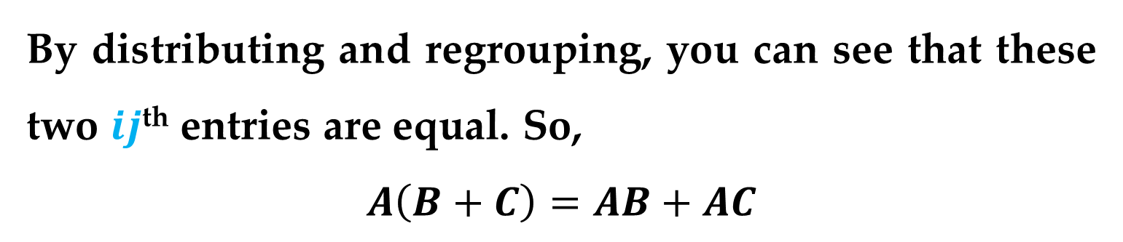
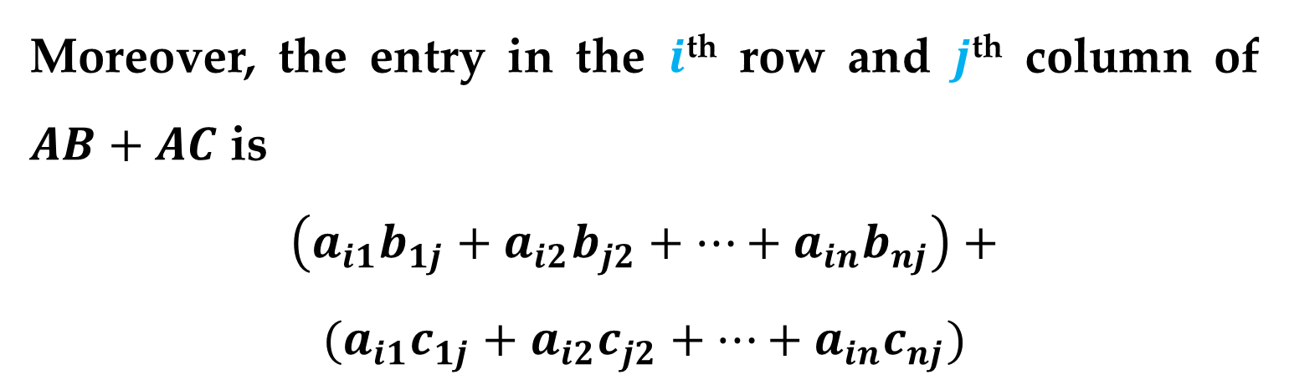
Proof (continued)
Moreover, the entry in the $i$^{th} row and $j$^{th} column of $AB+AC$ is
$$\left(a_{i1}b_{1j}+a_{i2}b_{j2}+…+a_{in}b_{nj}\right)+$$
$$(a_{i1}c_{1j}+a_{i2}c_{j2}+…+a_{in}c_{nj})$$
By distributing and regrouping, you can see that these two $ij$^{th} entries are equal. So,
$$A\left(B+C\right)=AB+AC$$
Properties: Matrix Multiplication

Slide 14
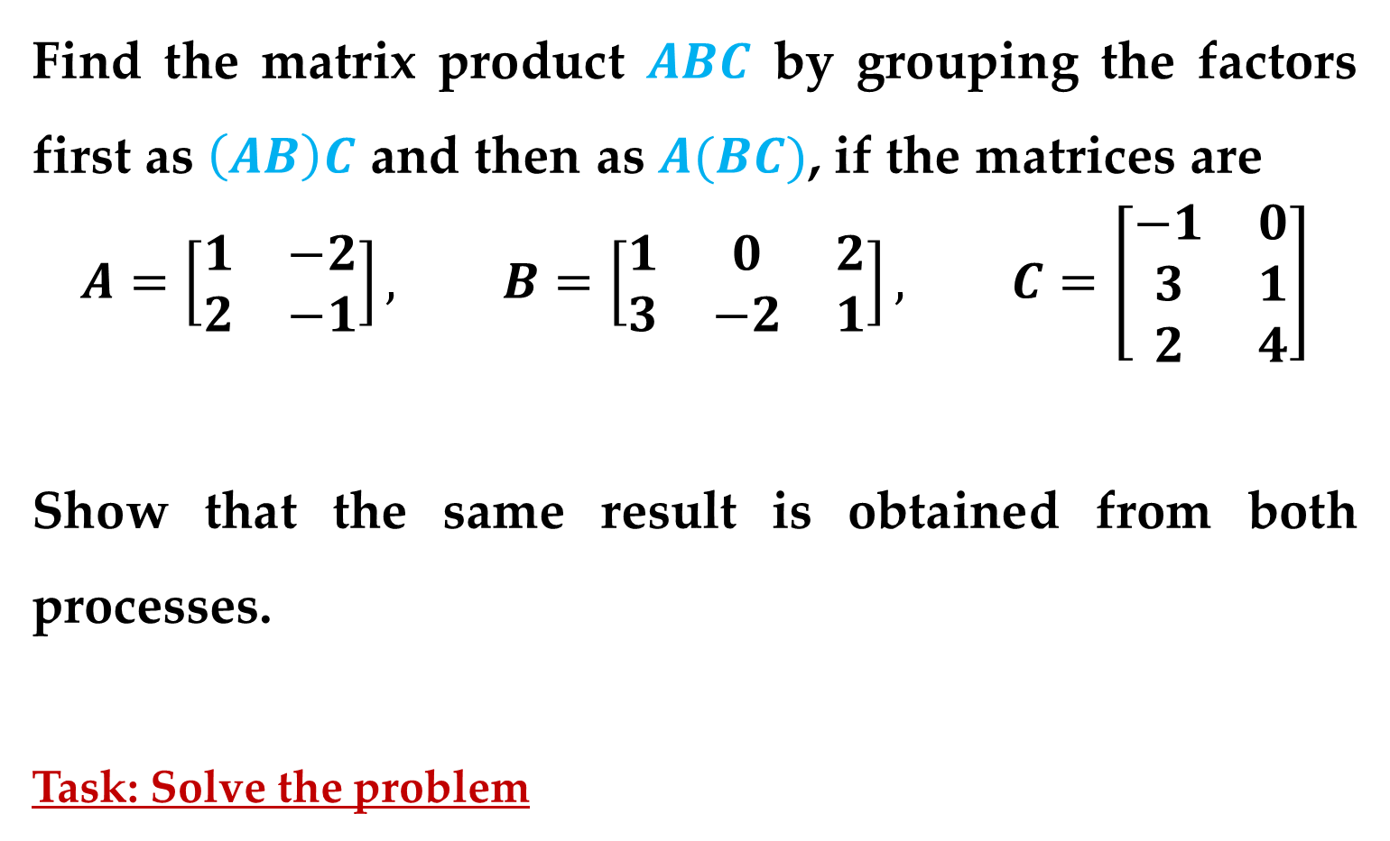
Example 3. Matrix Multiplication Is Associative
Find the matrix product $ABC$ by grouping the factors first as $\left(AB\right)C$ and then as $A(BC)$, if the matrices are
$$A=\left[\begin{matrix}1 & −2 \\ 2 & −1\end{matrix}\right], B=\left[\begin{matrix}1 & 0 & 2 \\ 3 & −2 & 1\end{matrix}\right], C=\left[\begin{matrix}−1 & 0 \\ 3 & 1 \\ 2 & 4\end{matrix}\right]$$
Show that the same result is obtained from both processes.
Task: Solve the problem
Properties: Matrix Multiplication

Slide 15
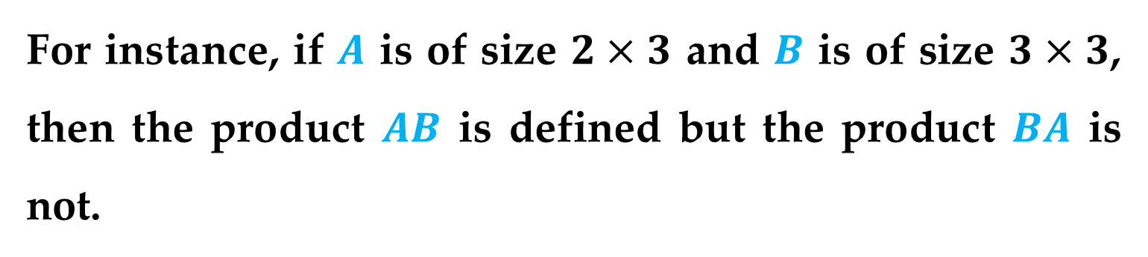
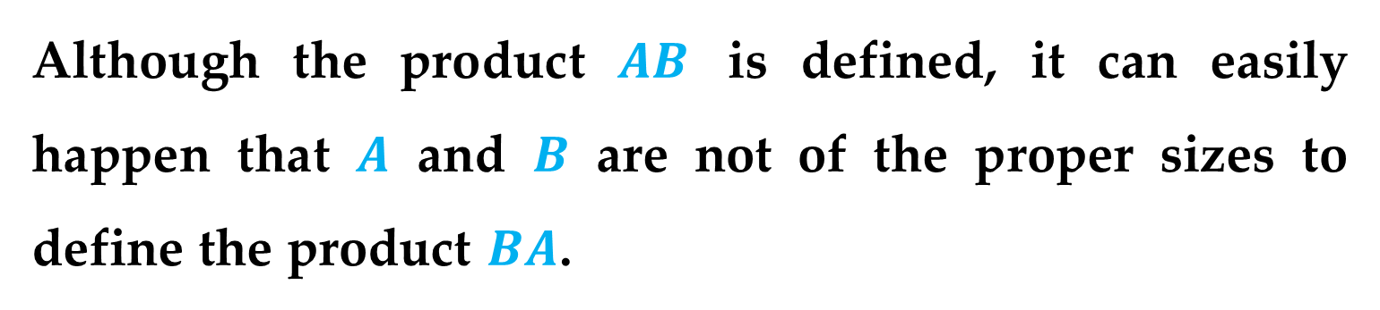
Remark
Note that no commutative property for matrix multiplication is listed in Theorem 3.
Although the product $AB$ is defined, it can easily happen that $A$ and $B$ are not of the proper sizes to define the product $BA$.
For instance, if $A$ is of size $2×3$ and $B$ is of size $3×3$, then the product $AB$ is defined but the product $BA$ is not.
Properties: Matrix Multiplication

Slide 16
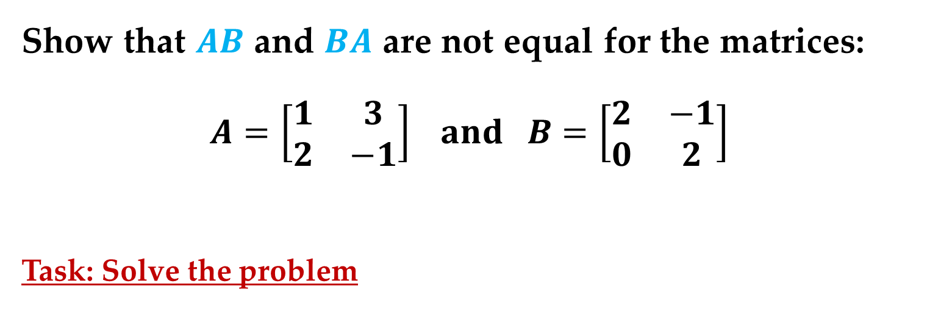

The next example shows that even if both products $AB$ and $BA$ are defined, they may not be equal.
Example 4. Noncommutativity of Matrix Multiplication
Show that $AB$ and $BA$ are not equal for the matrices:
$$A=\left[\begin{matrix}1 & 3 \\ 2 & −1\end{matrix}\right] and B=\left[\begin{matrix}2 & −1 \\ 0 & 2\end{matrix}\right]$$
Task: Solve the problem
Properties: Matrix Multiplication

Slide 17
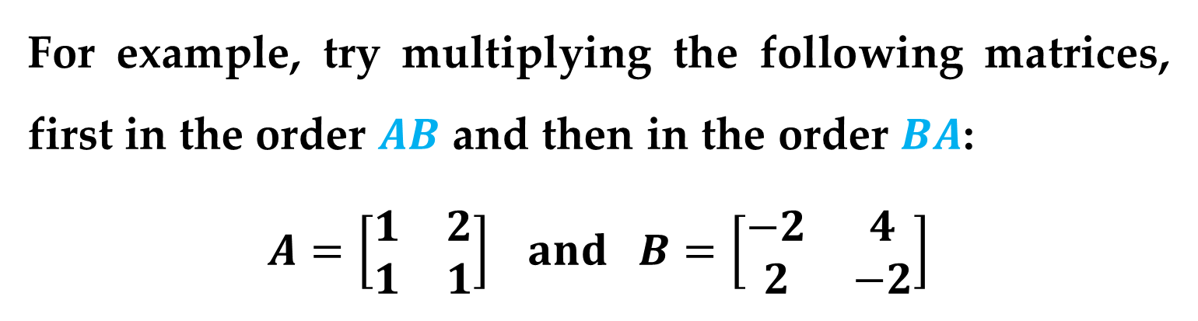
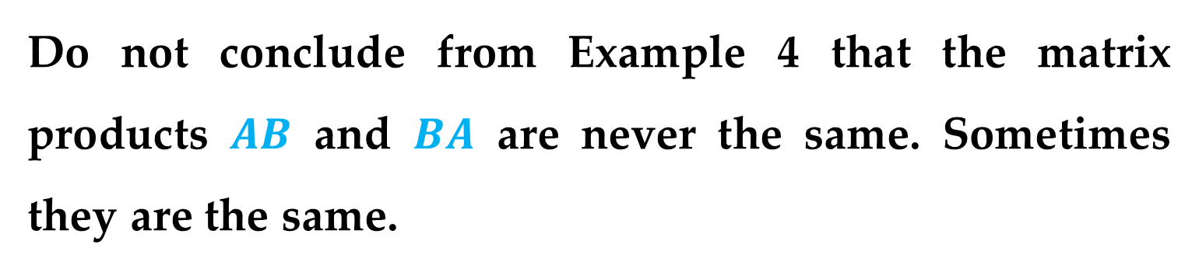
Remark
Do not conclude from Example 4 that the matrix products $AB$ and $BA$ are never the same. Sometimes they are the same.
For example, try multiplying the following matrices, first in the order $AB$ and then in the order $BA$:
$$A=\left[\begin{matrix}1 & 2 \\ 1 & 1\end{matrix}\right] and B=\left[\begin{matrix}−2 & 4 \\ 2 & −2\end{matrix}\right]$$
Properties: Matrix Multiplication

Slide 18
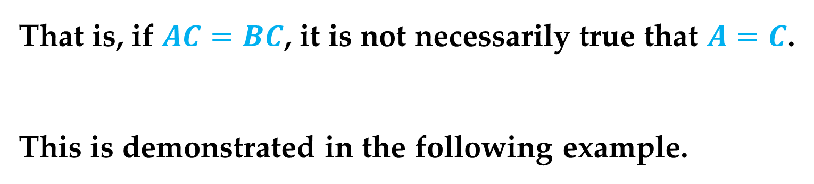
Remark
Another important quality of matrix algebra is that it does not have a general cancellation property for matrix multiplication.
That is, if $AC=BC$, it is not necessarily true that $A=C$.
This is demonstrated in the following example.
Properties: Matrix Multiplication

Slide 19
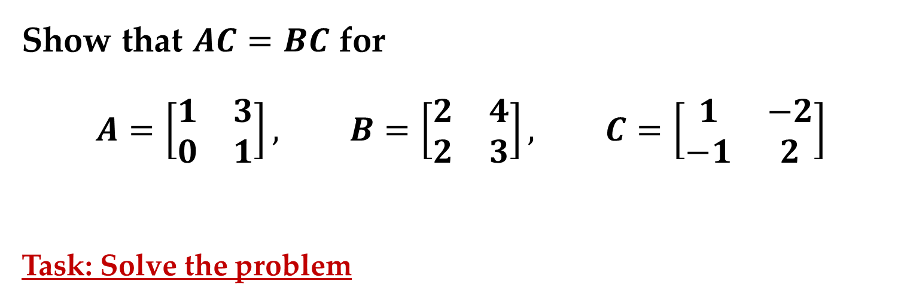
Example 5. An Example in Which Cancellation Is Not Valid
Show that $AC=BC$ for
$$A=\left[\begin{matrix}1 & 3 \\ 0 & 1\end{matrix}\right], B=\left[\begin{matrix}2 & 4 \\ 2 & 3\end{matrix}\right], C=\left[\begin{matrix}1 & −2 \\ −1 & 2\end{matrix}\right]$$
Task: Solve the problem
Properties: Matrix Multiplication

Slide 20
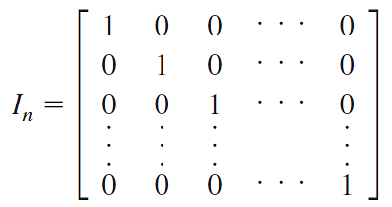
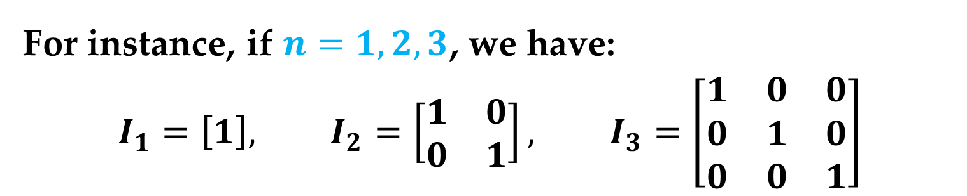
Consider a special type of square matrix that has 1’s on the main diagonal and 0’s elsewhere.
For instance, if $n=1,2,3$, we have:
$$I_{1}=\left[1\right], I_{2}=\left[\begin{matrix}1 & 0 \\ 0 & 1\end{matrix}\right], I_{3}=\left[\begin{matrix}1 & 0 & 0 \\ 0 & 1 & 0 \\ 0 & 0 & 1\end{matrix}\right]$$
Properties of the Identity Matrix

Slide 21
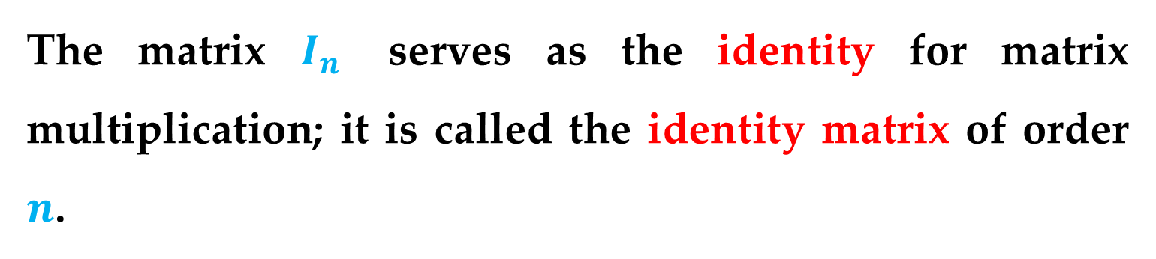
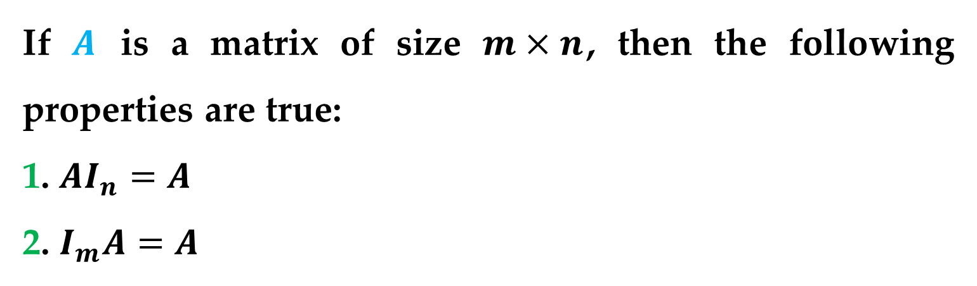
Definition (Identity Matrix)
The matrix $I_{n}$ serves as the identity for matrix multiplication; it is called the identity matrix of order $n$.
Theorem 4. Properties of the Identity Matrix
If $A$ is a matrix of size $m×n$, then the following properties are true:
1. $AI_{n}=A$
2. $I_{m}A=A$
Properties of the Identity Matrix

Slide 22
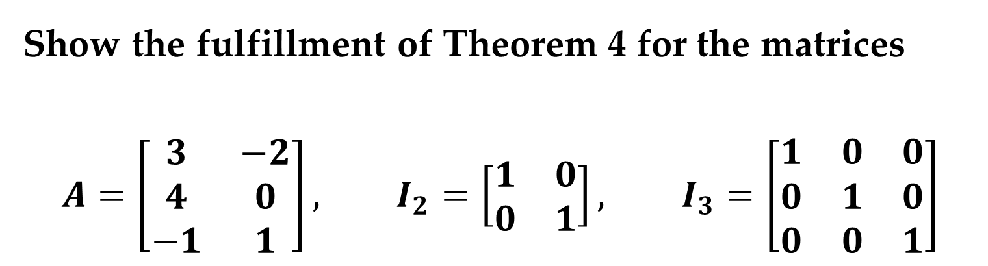
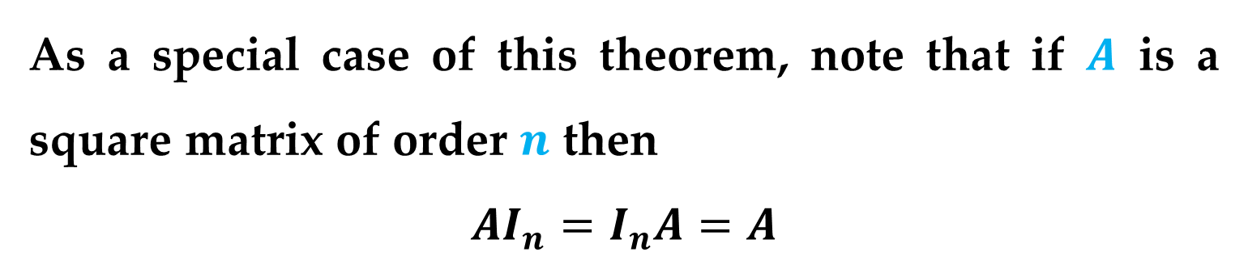
As a special case of this theorem, note that if $A$ is a square matrix of order $n$ then
$$AI_{n}=I_{n}A=A$$
Example 6. Multiplication by an Identity Matrix
Show the fulfillment of Theorem 4 for the matrices
$$A=\left[\begin{matrix}3 & −2 \\ 4 & 0 \\ −1 & 1\end{matrix}\right], I_{2}=\left[\begin{matrix}1 & 0 \\ 0 & 1\end{matrix}\right], I_{3}=\left[\begin{matrix}1 & 0 & 0 \\ 0 & 1 & 0 \\ 0 & 0 & 1\end{matrix}\right]$$
Properties of the Identity Matrix

Slide 23
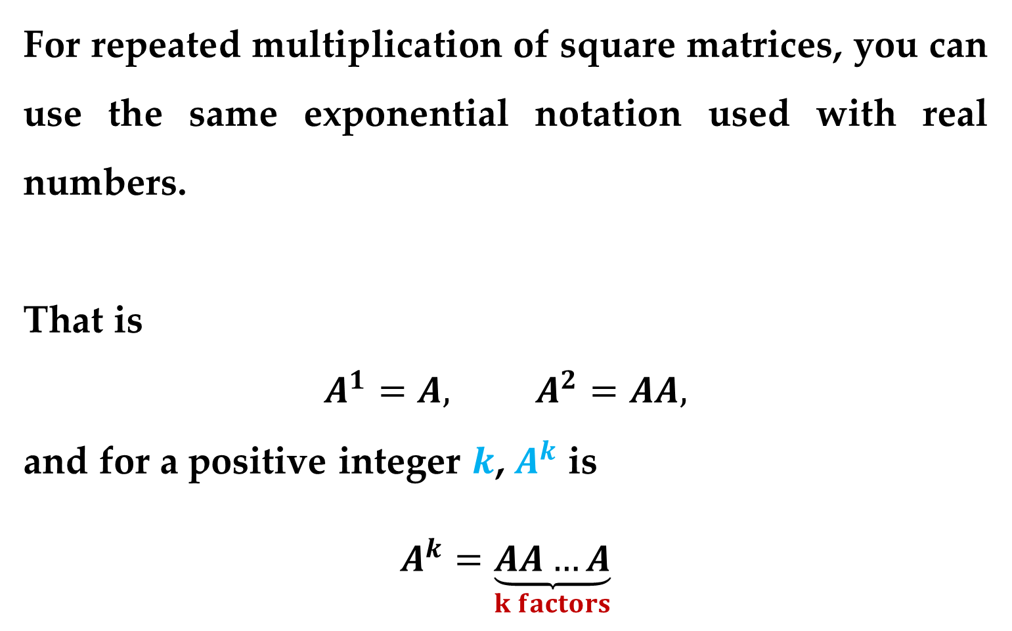
For repeated multiplication of square matrices, you can use the same exponential notation used with real numbers.
That is
$$A^{1}=A, A^{2}=AA,$$
and for a positive integer $k$, $A^{k}$ is
$$A^{k}=\underset{k factors}{\underbrace{AA…A}}$$
Properties: Matrix Multiplication

Slide 24
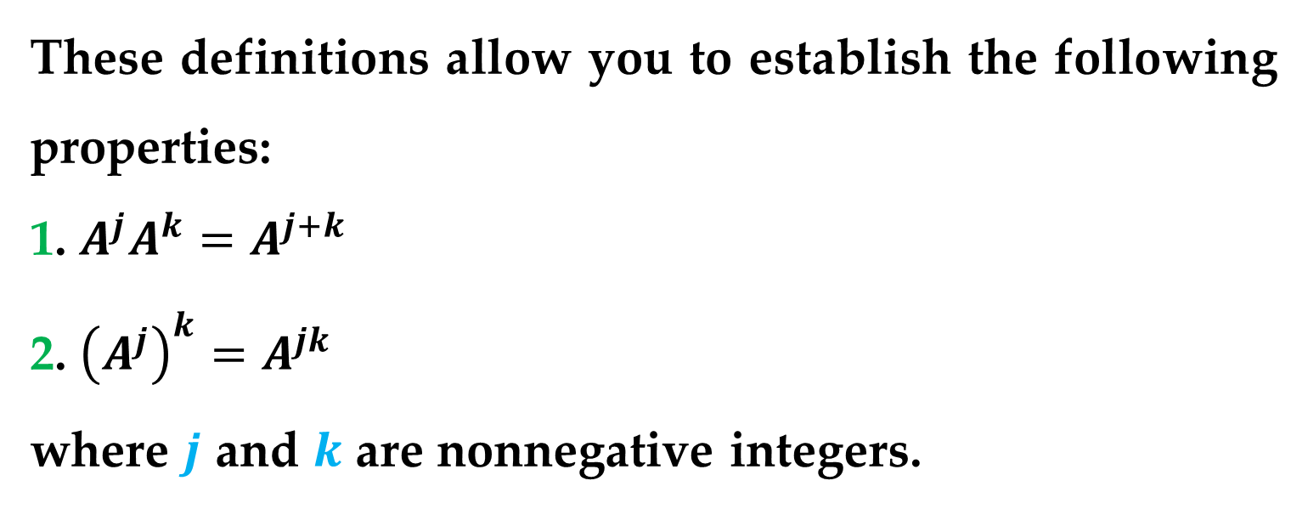
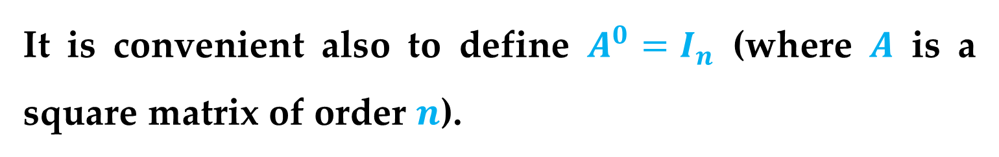
It is convenient also to define $A^{0}=I_{n}$ (where $A$ is a square matrix of order $n$).
These definitions allow you to establish the following properties:
1. $A^{j}A^{k}=A^{j+k}$
2. ${\left(A^{j}\right)}^{k}=A^{jk}$
where $j$ and $k$ are nonnegative integers.
Properties: Matrix Multiplication

Slide 25

Example 7. Repeated Multiplication of a Square Matrix
Find $A^{3}$ for the matrix
$$A=\left[\begin{matrix}2 & −1 \\ 3 & 0\end{matrix}\right]$$
Task: Solve the problem
Properties: Matrix Multiplication

Slide 26
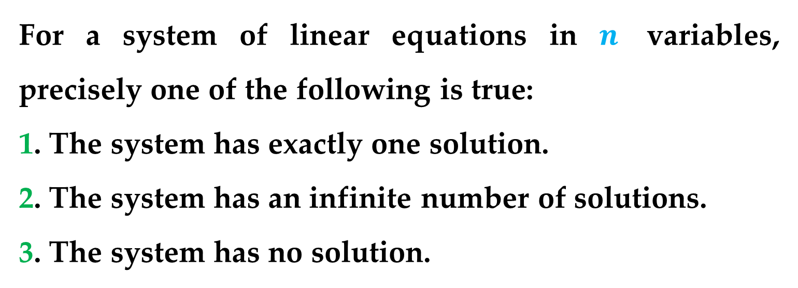
Using the matrix algebra developed so far, you can now prove the following important theorem.
Theorem 5. Number of Solutions of a System of Linear Equations
For a system of linear equations in $n$ variables, precisely one of the following is true:
1. The system has exactly one solution.
2. The system has an infinite number of solutions.
3. The system has no solution.
Properties of Matrix Operations

Slide 27
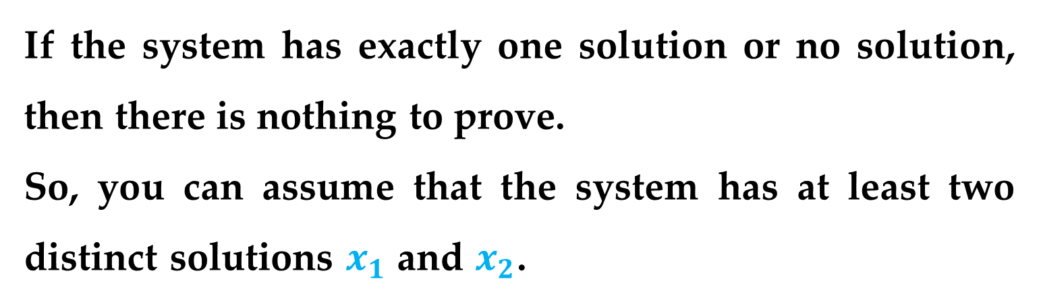
Proof
Represent the system by the matrix equation $Ax=b$.
If the system has exactly one solution or no solution, then there is nothing to prove.
So, you can assume that the system has at least two distinct solutions $x_{1}$ and $x_{2}$.
The proof will be complete if you can show that this assumption implies that the system has an infinite number of solutions.
Properties of Matrix Operations

Slide 28
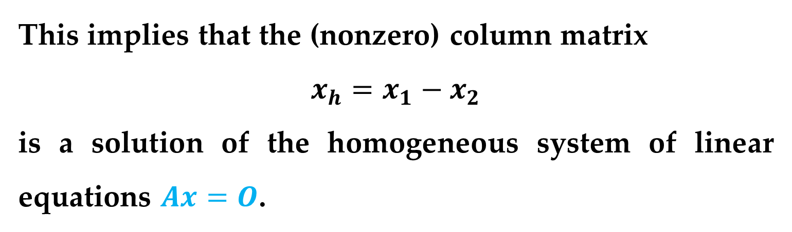
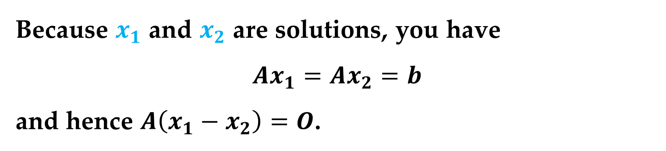
Proof (continued)
Because $x_{1}$ and $x_{2}$ are solutions, you have
$Ax_{1}=Ax_{2}=b$
and hence $A\left(x_{1}−x_{2}\right)=O$.
This implies that the (nonzero) column matrix
$$x_{h}=x_{1}−x_{2}$$
is a solution of the homogeneous system of linear equations $Ax=O$.
Properties of Matrix Operations

Slide 29
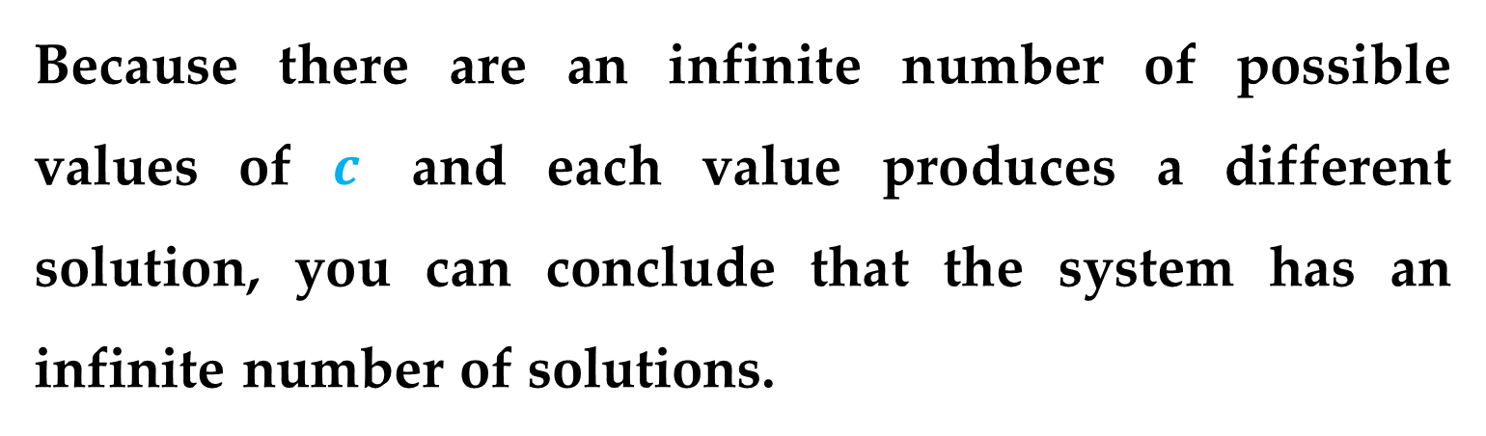
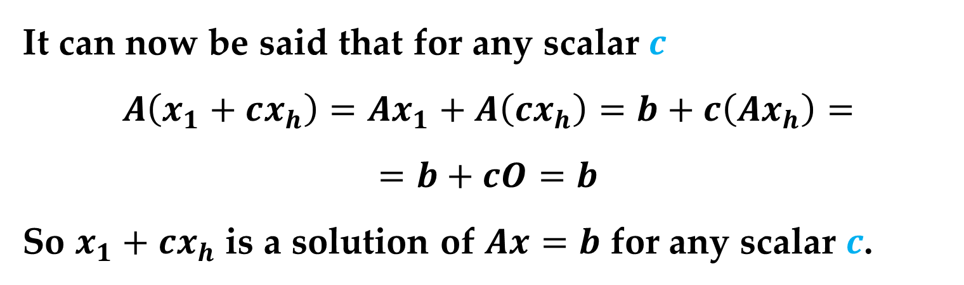
Proof (continued)
It can now be said that for any scalar $c$
$$A\left(x_{1}+cx_{h}\right)=Ax_{1}+A\left(cx_{h}\right)=b+c\left(Ax_{h}\right)=$$
$$=b+cO=b$$
So $x_{1}+cx_{h}$ is a solution of $Ax=b$ for any scalar $c$.
Because there are an infinite number of possible values of $c$ and each value produces a different solution, you can conclude that the system has an infinite number of solutions.
Properties of Matrix Operations

Slide 30
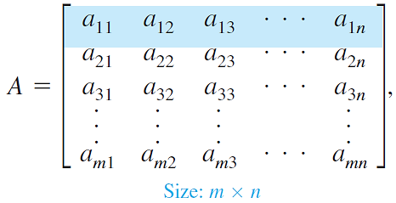
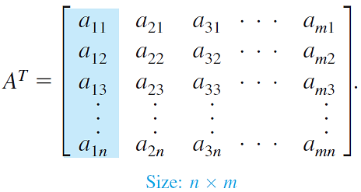
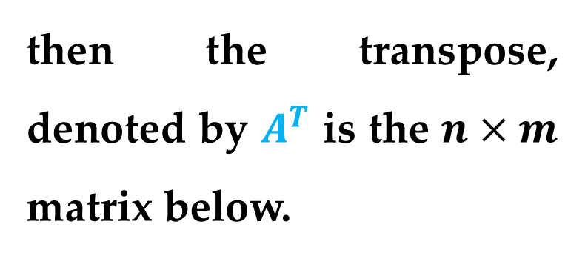
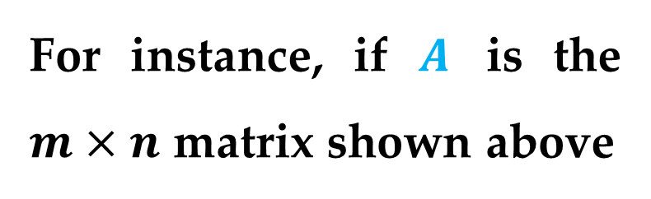
Definition
The transpose of a matrix is formed by writing its columns as rows.
For instance, if $A$ is the $m×n$ matrix shown above
then the transpose, denoted by $A^{T}$ is the $n×m$ matrix below.

Slide 31
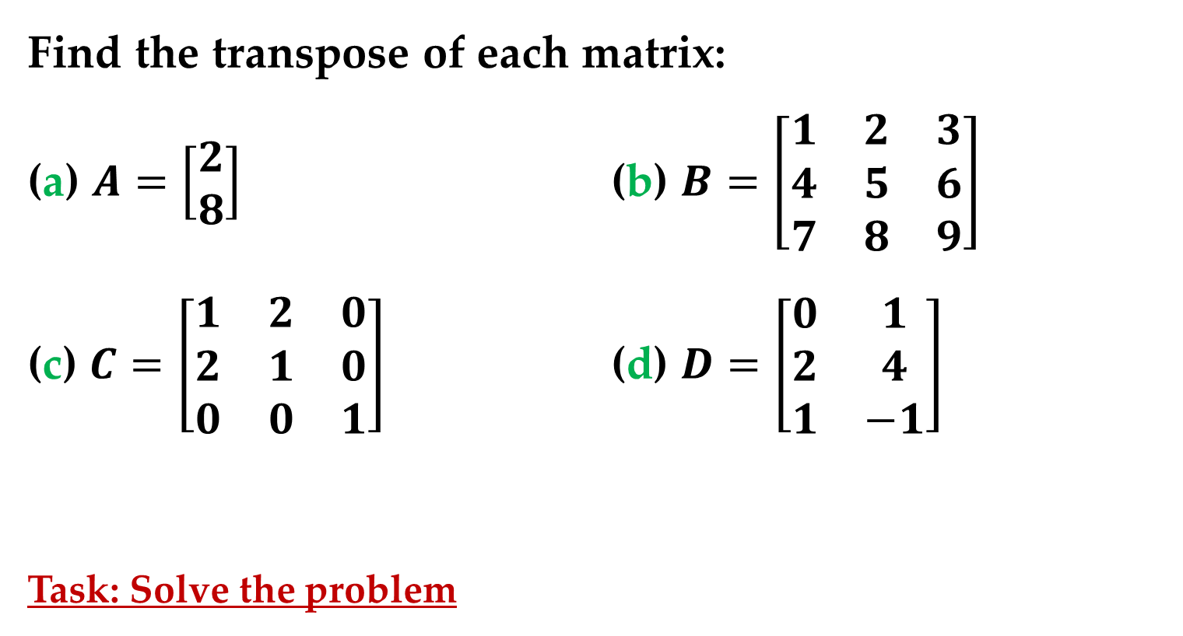
Example 8. The Transpose of a Matrix
Find the transpose of each matrix:
(a) $A=\left[\begin{matrix}2 \\ 8\end{matrix}\right]$ (b) $B=\left[\begin{matrix}1 & 2 & 3 \\ 4 & 5 & 6 \\ 7 & 8 & 9\end{matrix}\right]$
(c) $C=\left[\begin{matrix}1 & 2 & 0 \\ 2 & 1 & 0 \\ 0 & 0 & 1\end{matrix}\right]$ (d) $D=\left[\begin{matrix}0 & 1 \\ 2 & 4 \\ 1 & −1\end{matrix}\right]$
Task: Solve the problem
Transpose of a Matrix

Slide 32
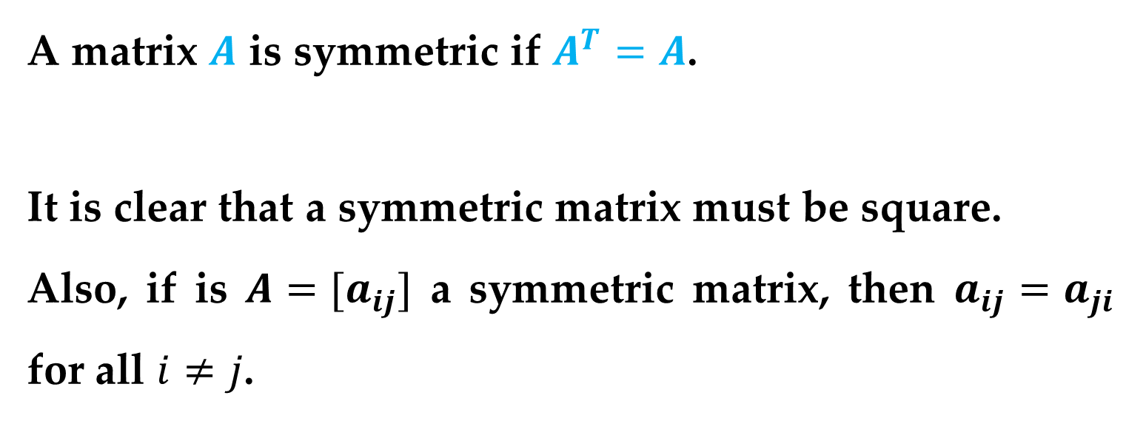
Note that the square matrix in part (c) of Example 8 is equal to its transpose. Such a matrix is called symmetric.
A matrix $A$ is symmetric if $A^{T}=A$.
It is clear that a symmetric matrix must be square.
Also, if is $A=[a_{ij}]$ a symmetric matrix, then $a_{ij}=a_{ji}$ for all $i≠j$.
Transpose of a Matrix

Slide 33
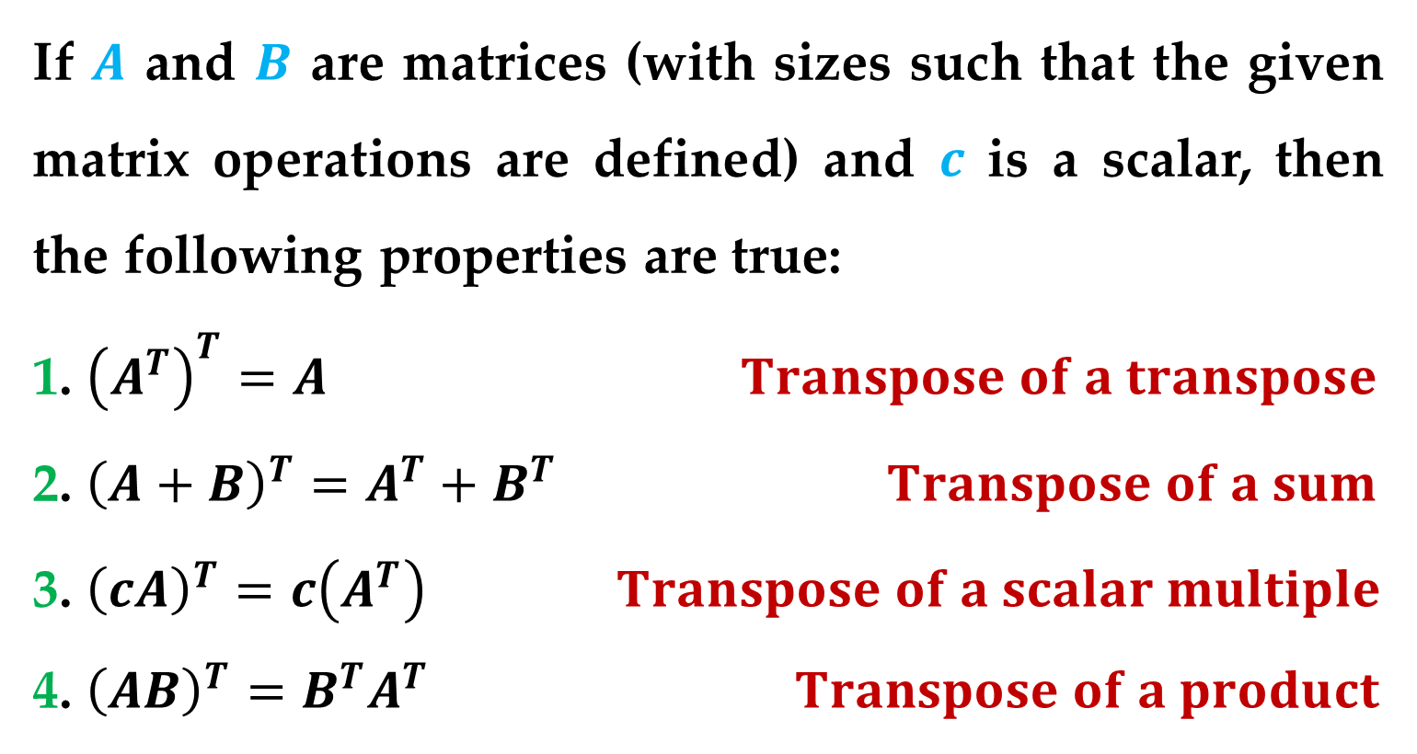
Theorem 6. Properties of Transposes
If $A$ and $B$ are matrices (with sizes such that the given matrix operations are defined) and $c$ is a scalar, then the following properties are true:
1. ${\left(A^{T}\right)}^{T}=A Transpose of a transpose$
2. ${\left(A+B\right)}^{T}=A^{T}+B^{T} Transpose of a sum$
3. ${\left(cA\right)}^{T}=c\left(A^{T}\right) Transpose of a scalar multiple$
4. ${\left(AB\right)}^{T}=B^{T}A^{T} Transpose of a product$
Transpose of a Matrix

Slide 34

Remark
Properties 2 and 4 can be generalized to cover sums or products of any finite number of matrices.
For instance, the transpose of the sum of three matrices is
$${\left(A+B+C\right)}^{T}=A^{T}+B^{T}+C^{T}$$
and the transpose of the product of three matrices is
$${\left(ABC\right)}^{T}=C^{T}B^{T}A^{T}$$
Transpose of a Matrix

Slide 35

Example 9. Finding the Transpose of a Product
Show that ${(AB)}^{T}$ and $B^{T}A^{T}$ are equal for the matrices:
$$A=\left[\begin{matrix}2 & 1 & −2 \\ −1 & 0 & 3 \\ 0 & −2 & 1\end{matrix}\right] and B=\left[\begin{matrix}3 & 1 \\ 2 & −1 \\ 3 & 0\end{matrix}\right]$$
Task: Solve the problem
Transpose of a Matrix

Slide 36

Example 10. The Product of a Matrix and Its Transpose
For the matrix
$$A=\left[\begin{matrix}1 & 3 \\ 0 & −2 \\ −2 & −1\end{matrix}\right]$$
find the product $AA^{T}$ and show that it is symmetric.
Task: Solve the problem
Transpose of a Matrix

Slide 37

Remark
The property demonstrated in Example 10 is true in general.
That is, for any matrix $A$, the matrix given by $B=AA^{T}$ is symmetric.
Transpose of a Matrix

Slide 38
Thank You for Attention

